Slide 1
dinosaurs

Slide 2
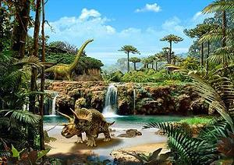
Millions of years ago, long before there were any people, there were dinosaurs. Dinosaurs were one of several kinds of prehistoric reptiles that lived during the Mesozoic Era, the "Age of Reptiles."

Slide 3
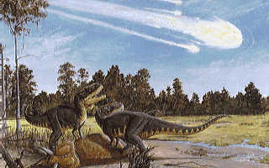
The dinosaurs went extinct about 65 million years ago, at the end of the Cretaceous period, which was a time of high volcanic and tectonic activity. There are a lot of theories why the extinction occurred. The most widely accepted theory is that an asteroid impact caused major climactic changes to which the dinosaurs couldn't adapt.

Slide 4
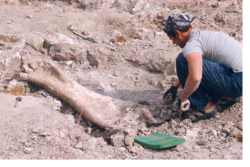
A paleontologist is a scientist who studies paleontology, learning about the forms of life that existed in former geologic periods, chiefly by studying fossils. The information you find about your dinosaur most likely originated from a paleontologist.

Slide 5
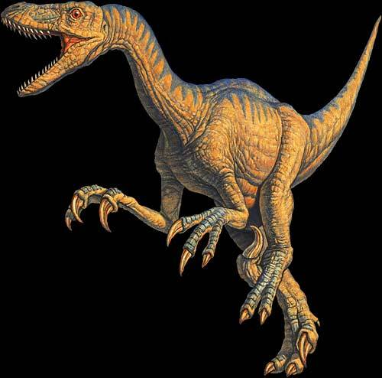
YOUR SLIDE should INCLUDE THE FOLLOWING:
Picture of the dinosaur
Name of the dinosaur and what its name means
Color, size, and physical characteristics of the dinosaur
Possible habitat and whether it was an herbivore, carnivore, or omnivore
An interesting fact or two about the dinosaur

