Slide 1
Famous Artwork
“BLUE”

Slide 2
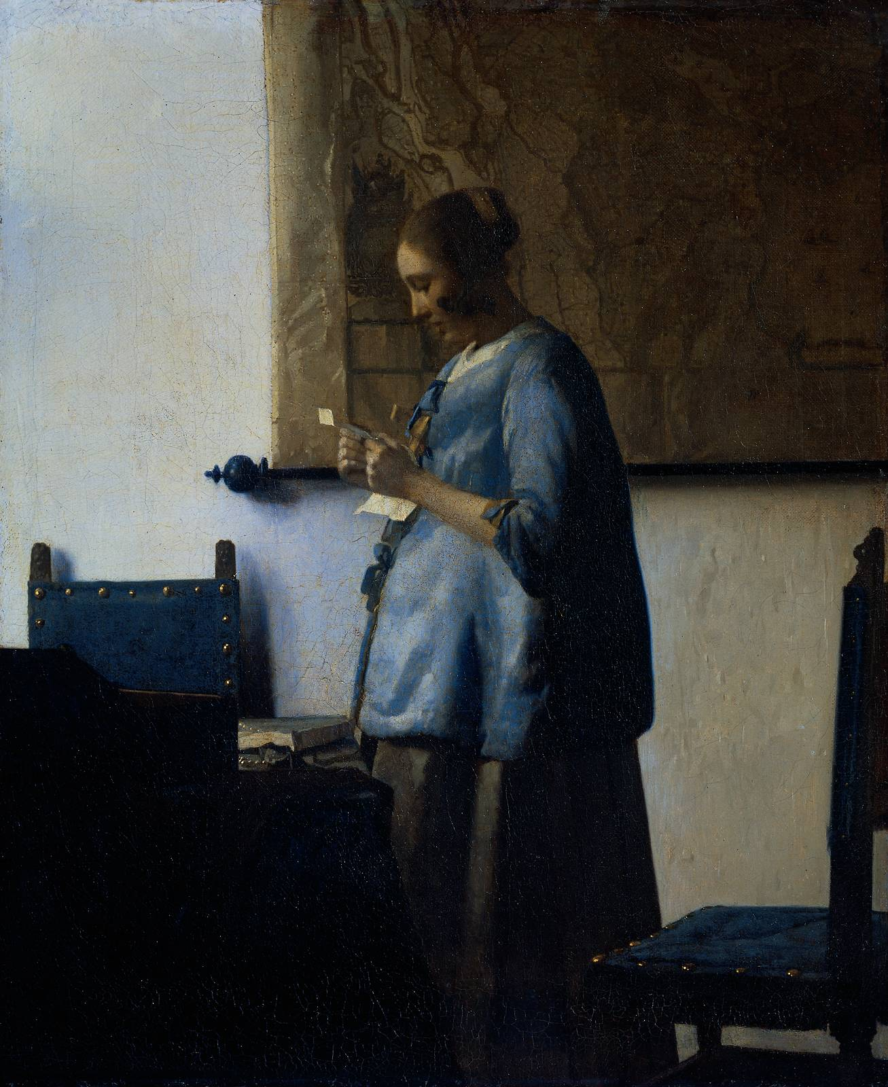
Woman in Blue Reading a Letter Jan Vermeer Blue dress and chairs express a calmness.

Slide 3
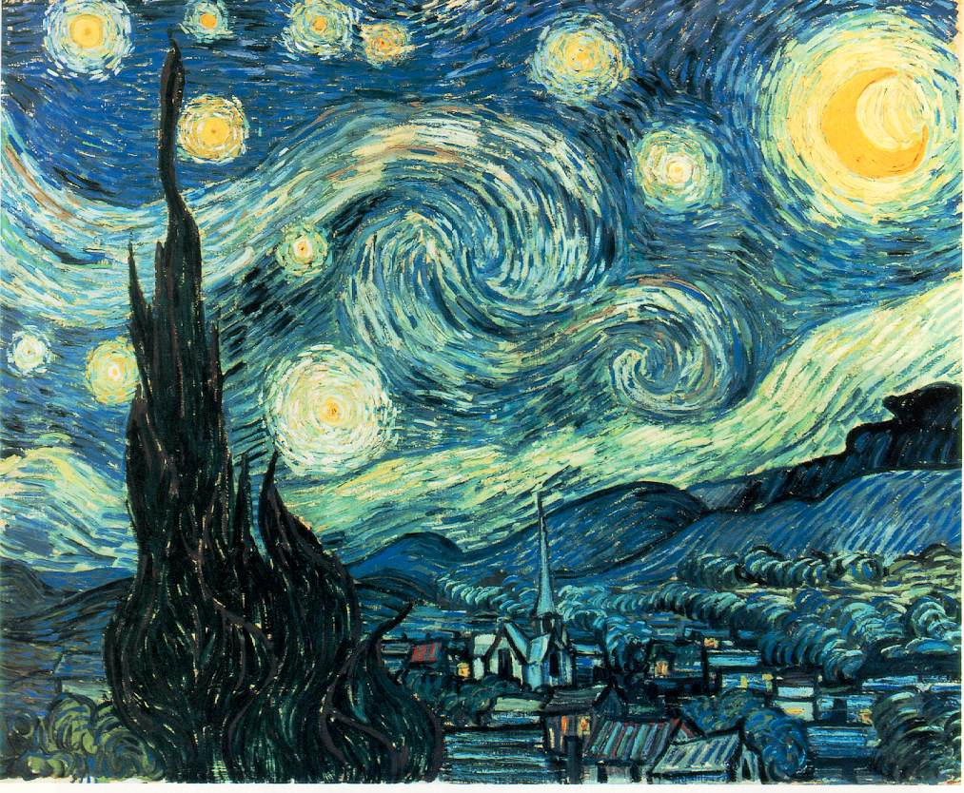
The Starry Night
Vincent van Gogh
Blue skies are restful,
yet burst of yellow
and churning seem
somewhat troubled.

Slide 4
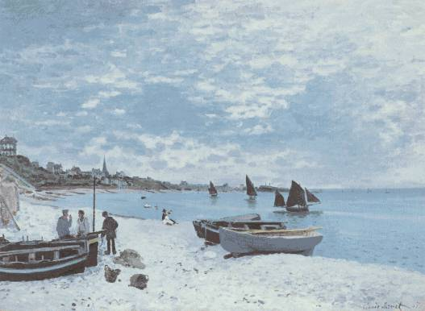
The Beach at Sainte-Adresse 1867
Blue skies and ocean
reflect the peacefulness
of the seaside.

Slide 5
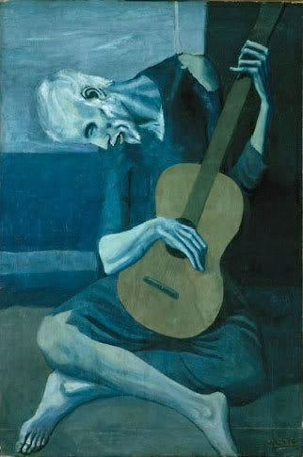
The Guitar Player
Pablo Picasso
The blue color reflects
melancholy and sadness,
maybe even misery.

